Slide 1
First year practicals
Lab 10: Attention and Inhibition of Return 2
Data analysis

Slide 2
Reminder of what we did
In the last session we built a Posner Cueing Task
Subjects had to detect the presence of a target presented in one of 2 locations (left or right box)
Each trial presented a peripheral pre-cue (box outline highlighted) which was non-predictive of the target location
i.e. validity of the cue was 50:50
Notes:
The cue predicted the location of the target only on 50% of the trials. It was therefore uninformative and should have been ignored!

Slide 3
What we expect
Despite the fact that the pre-cue is of no real use, we cannot help but covertly move our attention to where the peripheral cue is
This will lead to faster target detection times for VALID trials vs. INVALID ones
BUT…
If nothing happens at the cued location for a while then maybe attention will disengage and move back to the centre
Therefore we may expect the difference between valid/invalid reaction times will be influenced by the size of the delay between the onset of the cue and onset of the target (CTOA)

Slide 4
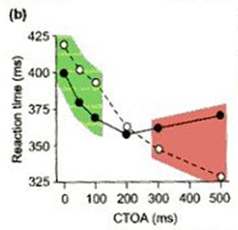
A graph of possible data
For short CTOAs we expect RTs for valid trials to be faster than invalid trials
However, at some point (around 200ms!) the benefit for valid trials will reverse such that:
For longer CTOAs we expect RTs for valid trials to be slower than invalid trials
Black (filled circles) are valid trials
White are invalid trials

Slide 5
Structure/Timings of Exp’t
CUE (Duration 100ms)
ISI/cue-target interval (Duration variable: 50, 100, 300)
TARGET (Duration 2000ms or until response)
TIME
The 2 key variables manipulated were CTOA and Validity of the cue
CTOA is the time from the ONSET of the Cue to the ONSET of the Target
SUMMARY:
2 IVs
Validity - 2 levels
CTOA - 3 levels
1 DV – Reaction time (msecs)
CTOA of 150, 200 & 400 msecs

Slide 6
Designs with more than 1 IV (factor)
These designs are more complicated than simpler designs that manipulate only 1 IV at 2 levels (like most of your practicals so far)
We would normally use a statistical procedure known as Factorial Analysis Of Variance (ANOVA) to examine the effects of our IV manipulations on the data
However, as you have not been taught Factorial ANOVA we are going to simplify the design and use a ONE-WAY ANOVA instead.

Slide 7
Creating a simpler design
We can collapse data over the Validity factor by simply calculating a difference score
We mentioned this the other week in the introductory session
We did a similar thing for the Pseudohomophone practical last semester
Difference score = RT Invalid – RT Valid
So now we can simply look at the effect of CTOA on these difference scores (so our analysis looks at just one IV)

Slide 8
Difference scores
Difference score = RT Invalid – RT Valid
+ ve diff = Faster for valid cues
-ve diff = Slower for valid cues
No difference (0) = same for both valid /invalid cues (cross over point)
Black (filled circles) are valid trials
White are invalid trials

Slide 9
Running a one-way ANOVA on the difference scores
From the data we calculate 3 difference scores
One for each level of our CTOA factor
If there is no effect of CTOA then the difference scores won’t change (Null hypothesis)
If there is an effect of CTOA then we might expect to see some significant differences between the difference scores
i.e. a main effect of CTOA

Slide 10
What does a one-way ANOVA tell us?
It tells us whether any of the means (the difference score) significantly differ from one another
It does NOT tell us however, which means differ
If we find a significant main effect of a factor (CTOA) then we need to follow-up with what is called a post-hoc test
We can use t-tests to compare pairs of means

Slide 11
There are 2 types of one-way ANOVA!!!!
Which do we use?
One-way within-subjects ANOVA
One-way between-subjects ANOVA
The answer depends on how we manipulated our factor (CTOA) in this design
Did we test all subjects on all levels of CTOA or did we test 3 separate groups each on one level of CTOA?

Slide 12
Lets run a within-subjects (related) one-way ANOVA
So lets get outputting your data and analysing it
We can follow-up the ANOVA with some related t-tests if there is a significant main effect
So what data do we need and what form is it currently in?
We need mean difference scores to analyse for all 3 levels of our IV (CTOA)
So we need 3 scores from each subject
Currently we have RTs for valid and invalid trials in separate .edat files (one for each subject)

Slide 13
E-Prime data output
You should each have tested 1 or 2 subjects
This produces .edat files
Lets open one and examine what’s inside!

Slide 14
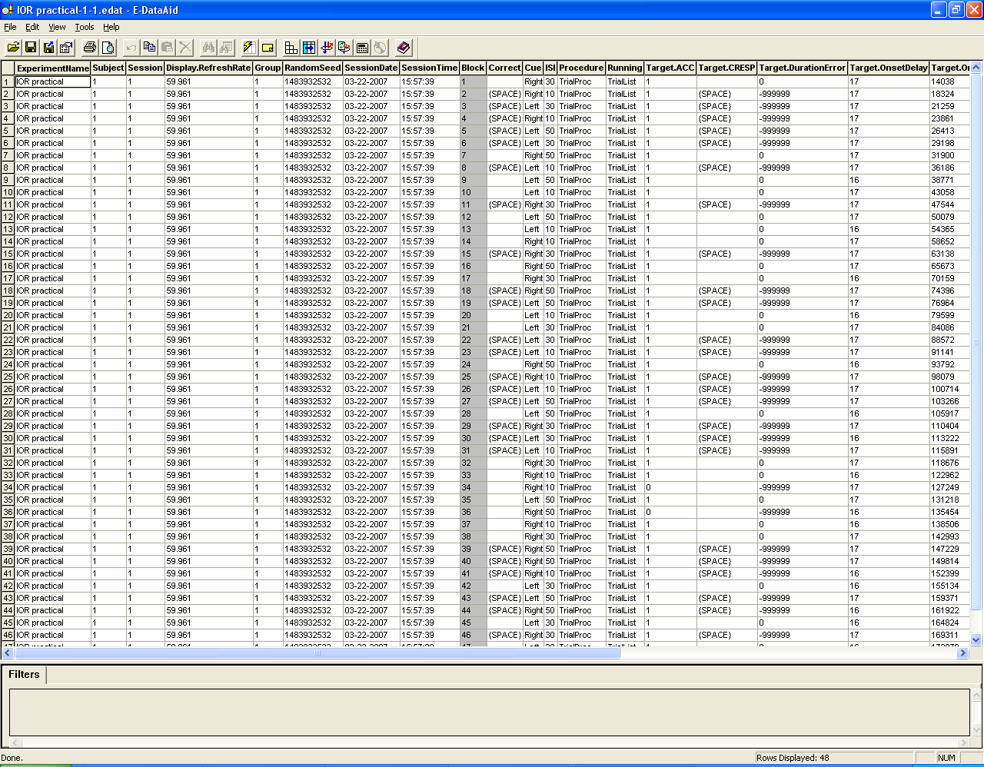
You should have 144 rows of data for each subject

Slide 15
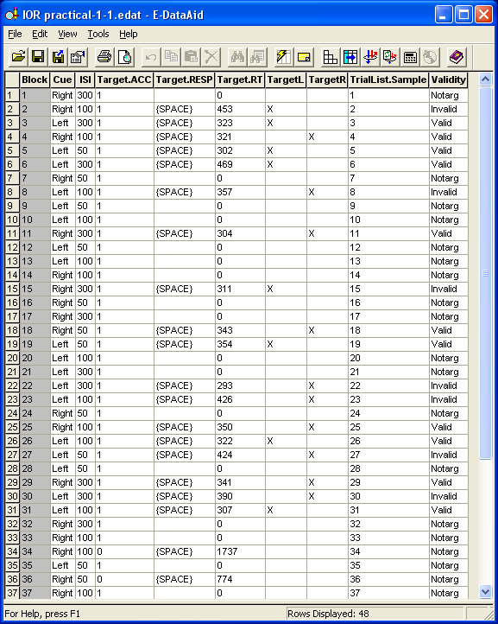
Much of this output is not needed, so let’s just look at what we need:
Validity
ISI (duration of the ISI slide - used to manipulate CTOA)
Target.ACC
Target.RT

Slide 16
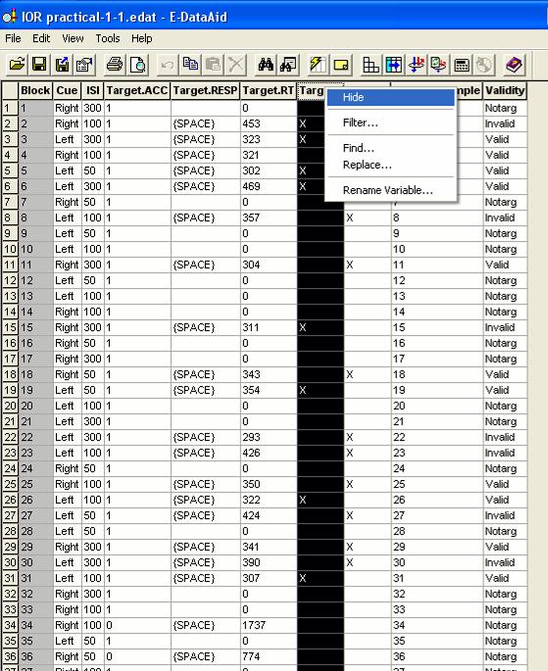
Right-click unwanted columns and click Hide
Validity
ISI
Target.ACC
Target.RT
No data has been deleted, just hidden to simplify viewing

Slide 17
So what do we need to analyse?
We need to break the RT data up according to Valid/Invalid trials and also the 3 ISI’s.
We are only interested in Target Present trials so we can filter out notarg trials using the validity column
This will reduce our trials by half (to 72 trials)!
We are also only interested in trials when you made a correct response
So we can filter the data by Target.ACC too

Slide 18
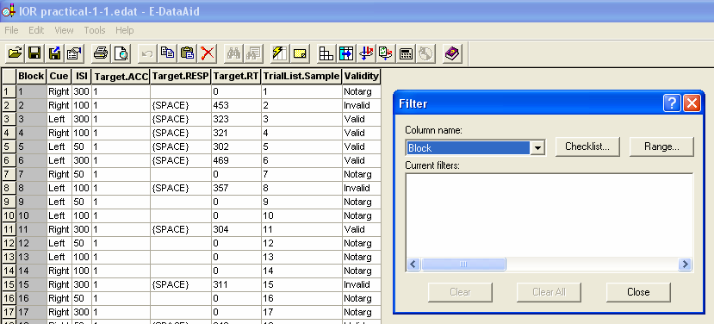
Filter out data from unwanted trials

Slide 19
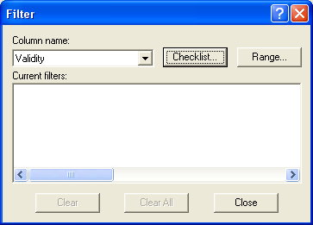
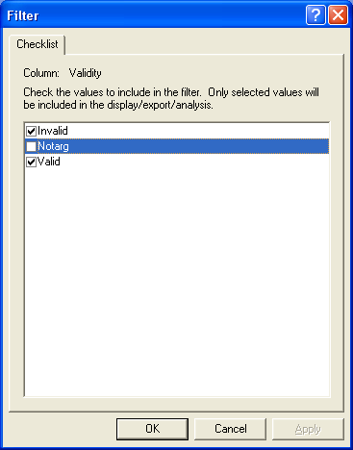
Filter out Target Absent trials
Choose the filter: Tools – Filter
Select Validity in the column name box
Then click ‘Checklist’
Tick only the valid and invalid trials (NOT Notarg!!)- Click OK
Your data will be visibly reduced by half

Slide 20
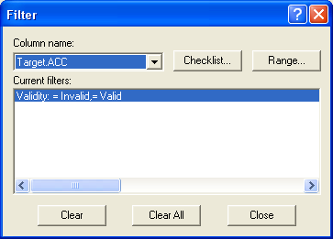
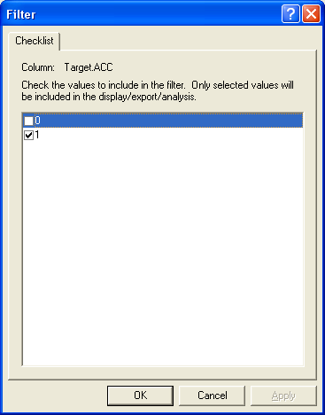
Let’s now get rid of Incorrect Responses
Select Target.ACC in the column name box
Then click ‘Checklist’
Tick only the correct responses (1)
Your data may be reduced

Slide 21
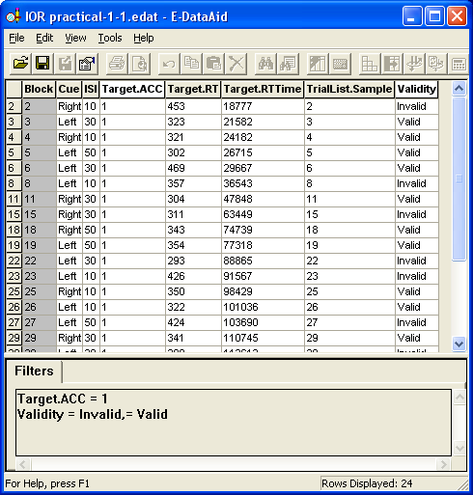
So before we output the means make sure you have filtered the data!
Filters selected are listed here

Slide 22
We can now calculate the mean RT’s for each cell of the design
 |  | CTOA [Cue duration (100) + ISI duration]
 |  | 150 | 200 | 400
Validity | Valid | Mean RT (from max 12 trials) | Mean RT (from max 12 trials) | Mean RT (from max 12 trials)
 | Invalid | Mean RT (from max 12 trials) | Mean RT (from max 12 trials) | Mean RT (from max 12 trials)
 |  | Diff scr | Diff scr | Diff scr
So we need to output the following means, which we can then copy into SPSS
We will however, calculate a difference score and then run the ANOVA

Slide 23
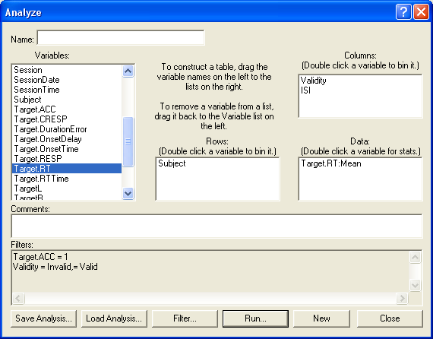
Let’s use the Analyze function in E-data aid
Bring Validity and then ISI into the columns box
Subject into Rows
Target.RT into Data
Click Run

Slide 24
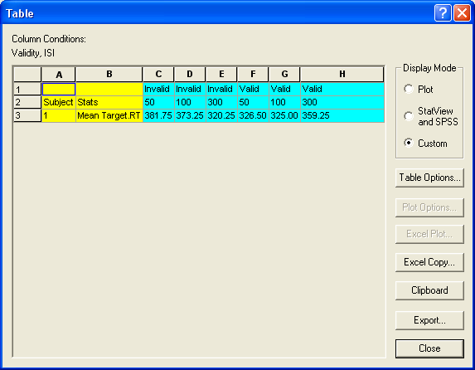
This will give you your means for the 6 cells of the design
Now calculate the difference scores for each of the 3 ISIs
Diff = Invalid-Valid
Write down 3 diff scores on results sheet
-
For 50ms ISI
(150 CTOA)
= +55.35ms

Slide 25
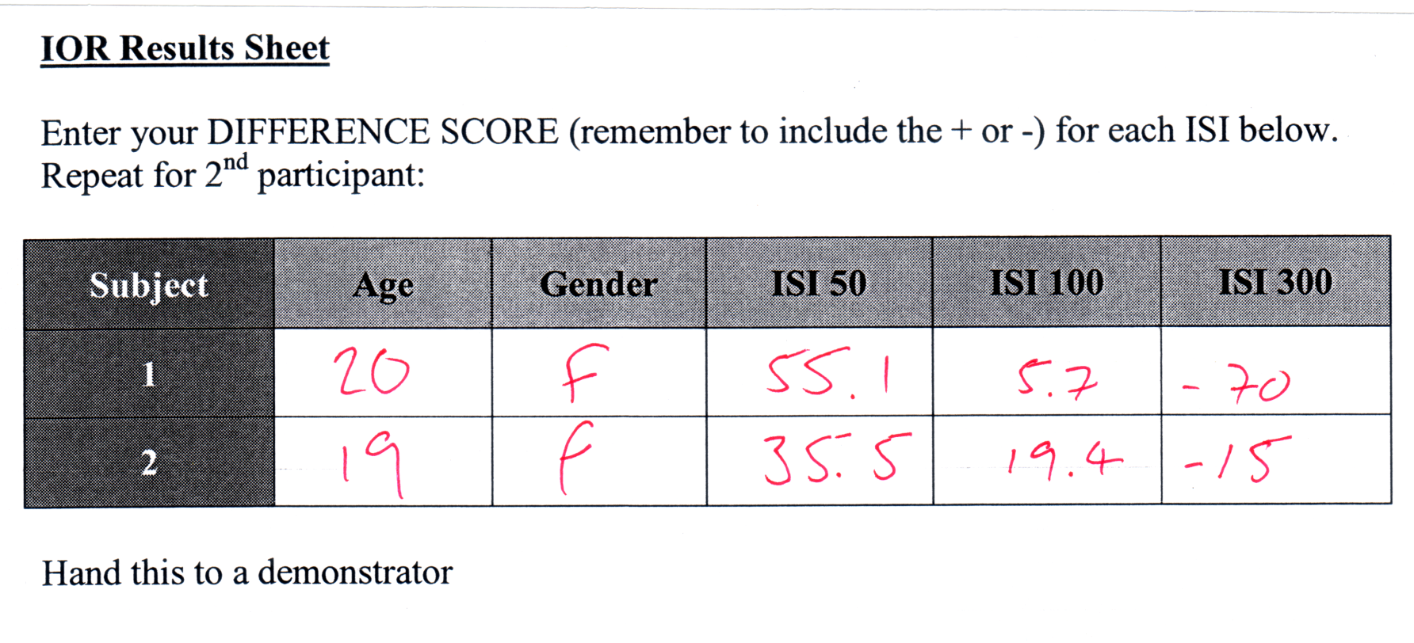
Record data for 2 participants

Slide 26



Let’s have a break whilst we input your data into Excel

Slide 27
OK time to get data into SPSS and analyse it!
Really what we have manipulated is CTOA
So you will need to add 100 (duration of cue) to each ISI to give the 3 levels of the CTOA
Set-up the variable names in SPSS (one column for each CTOA)
Run a repeated-measures ANOVA
Follow up a signif. main effect with Bonferroni Paired-t-tests

Slide 28
A question to consider
Research suggests that IOR starts when attention has disengaged from a specific spatial location.
How could your experimental paradigm be changed to encourage the onset of IOR?

Slide 29


Further info on SPSS can be found in:
P 306 onwards
P 427 onwards

